Slide 1
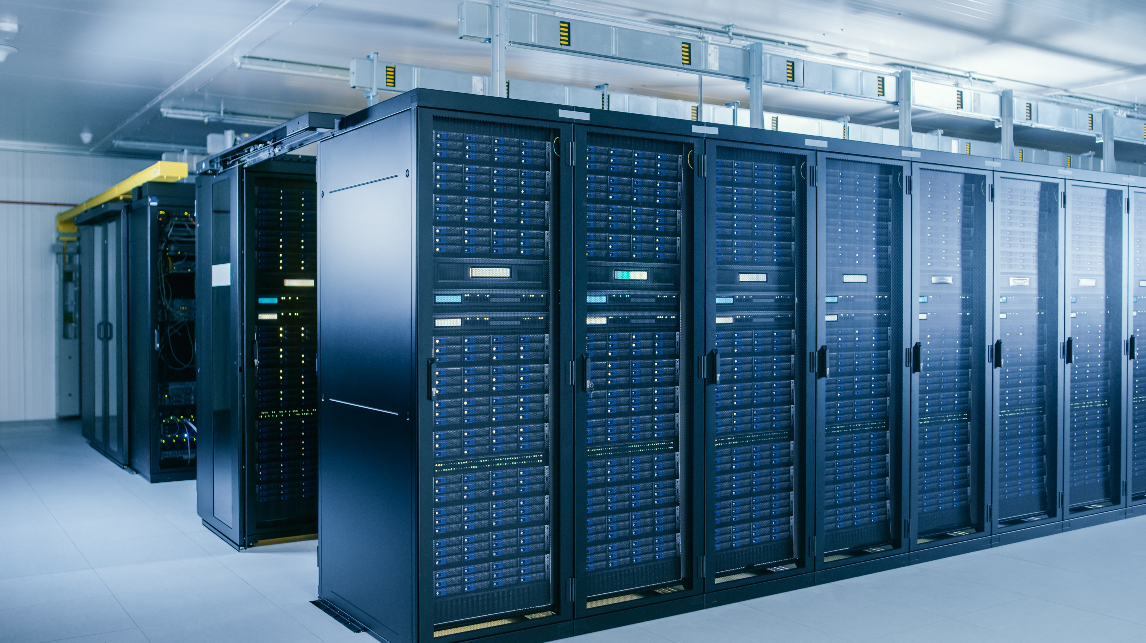

27 Jan 2025
Build The Future More Efficiently ™

Slide 2





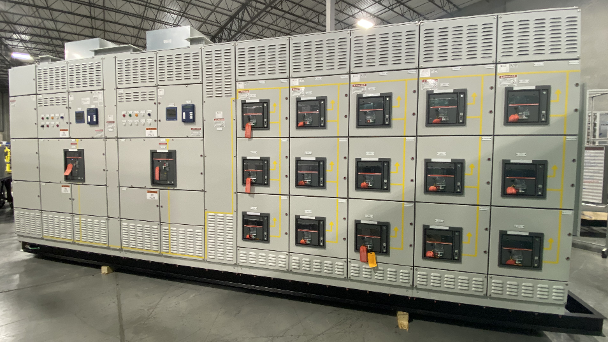




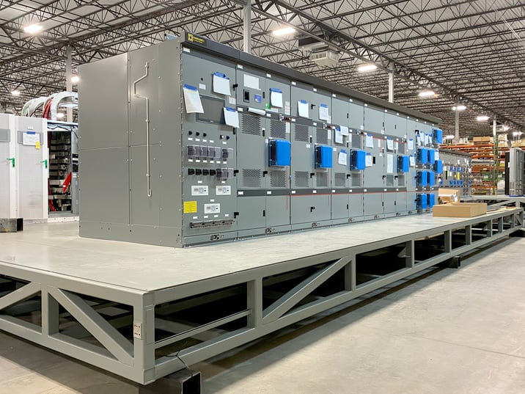


PCX History in Volumetric Construction
Founded
Acquired
CSP
Hyperscalers
Social media
Expanding 2025 for
next generation
solutions
1993
2002
2010
2016
2022

Slide 3


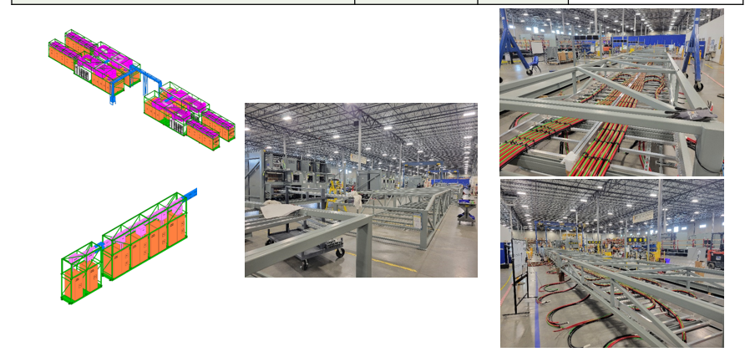
PCX Data Center Modular Journey in Volumetric Construction
Expanding 2025 for
next generation
solutions
AI
PEC
Type 1
Tetris V2
Type F
Tetris V3
10X
Gillian/Fremont
2010
2016
2022
2024
2025
2025
2025
Raised Floor
Perimeter Tile /
Floor Cooling
Slab Floor
Compact Design
LQ or Service
Isle Air Cool
Slab Floor
LQ or Service
Isle Air Cool
Slab Floor
Compact Design
LQ or Service
Isle Air Cool
Slab Floor
Liquid Cooling
Slab Floor
Liquid Cooling

Slide 4
PCX Manufacturing Capabilities
Structural steel and sheet metal fabrication
  Welding - AWS certified welders
  UL 870 - wireway, auxiliary gutters and fittings
Painting and coatings
  Sandblasting capability
  Paint booths with drying capabilities
Enclosure fabrication
  UL QRXA – commercial and industrial prefabricated buildings
Electrical assembly
  UL 508A industrial control panels
  UL 891 dead front switchboards

Slide 5
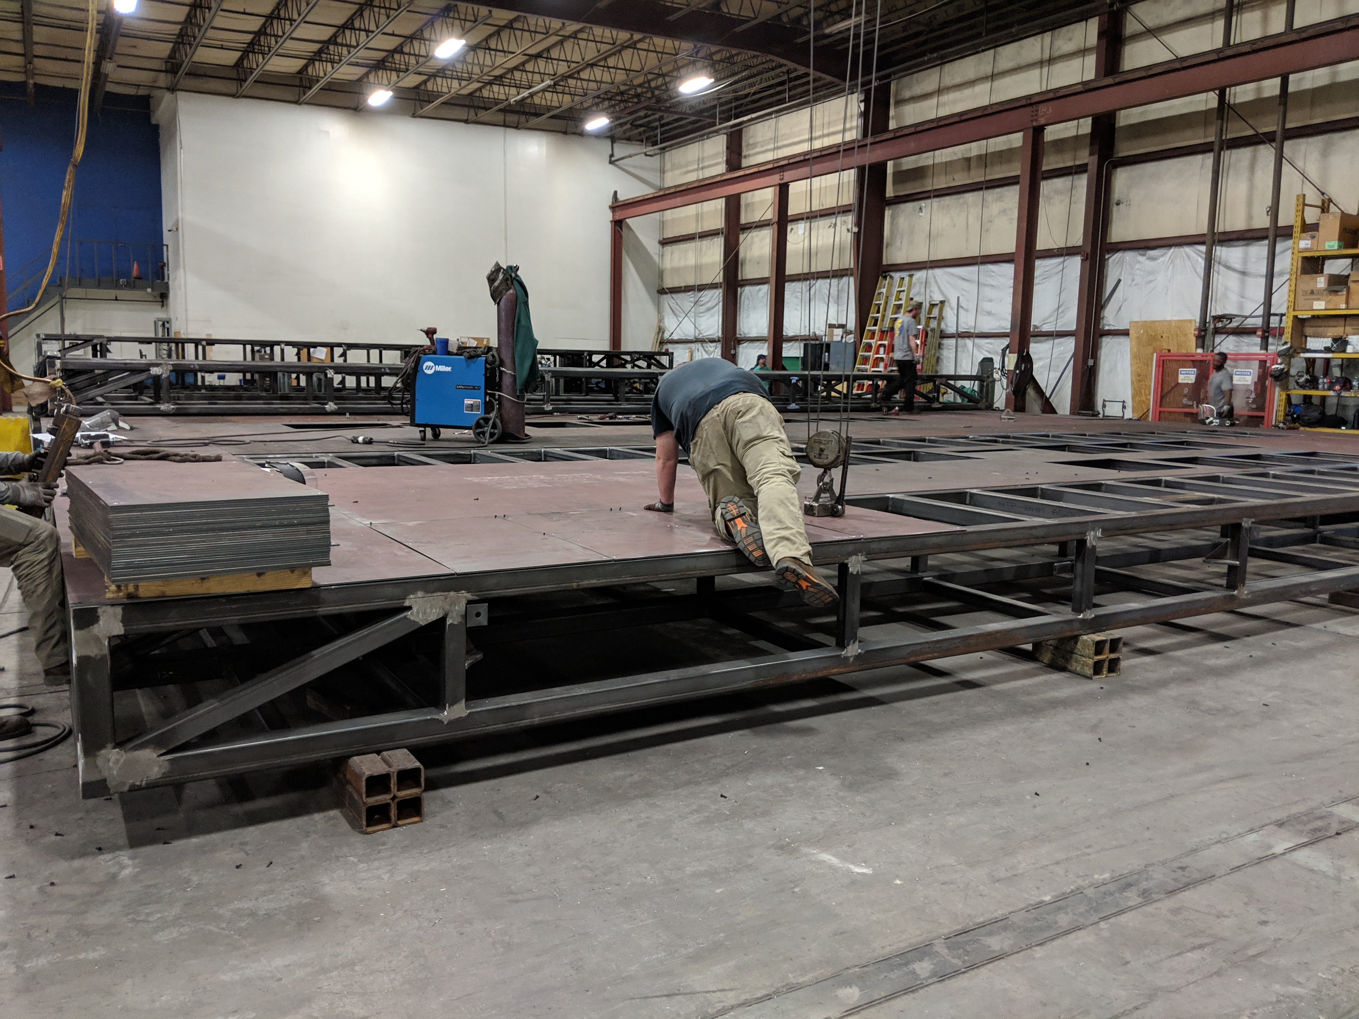
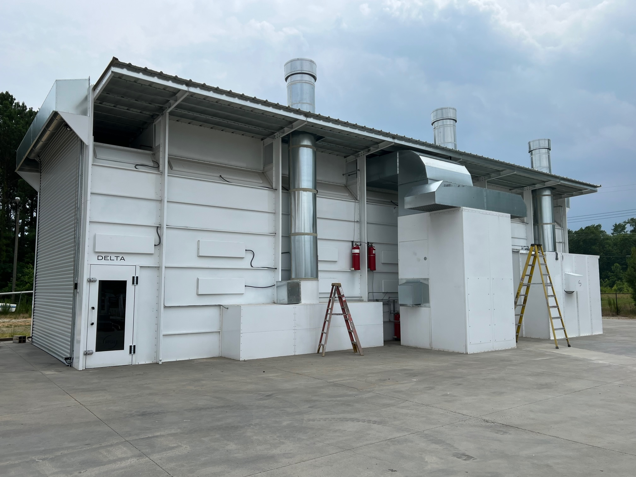
Location – Clayton, NC (67,000 sq ft)
Headquarters
  Welding
  Fabrication
  Painting
  500kW solar
  generation

Slide 6
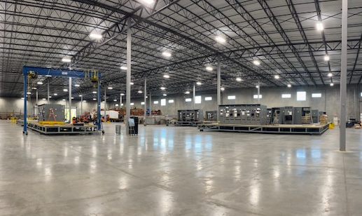
Location – Knightdale, NC (160,000 sq ft)
Built-to-suit facility
  System integration and
  pre-wiring
  Factory witness testing
  Packaging
  Shipment
Contemplating additional expansion

Slide 7
Engineering Team
Deep experience in specification, design, manufacture, test, and shipment of modular electrical and mechanical systems
  Medium voltage transformers and distribution
  Low voltage electrical rooms
  Mechanical systems with chillers, economizers, water storage, controls, pumping, and piping
  Traditional and close-coupled data center cooling methods
  Refrigeration systems with adjacent heat rejection packages
  Emergency power generation, hydroelectric power, and cogeneration systems

Slide 8
Engineering Tools
Design optimization: SOLIDWORKS Simulation Professional Finite
Element Analysis (FEA)
Flow simulation: SOLIDWORKS Flow Simulation Computational Fluid
Dynamics (CFD)
PipeFlow for fluid calculations and system simulations
ETAP arc flash analysis software

Slide 9
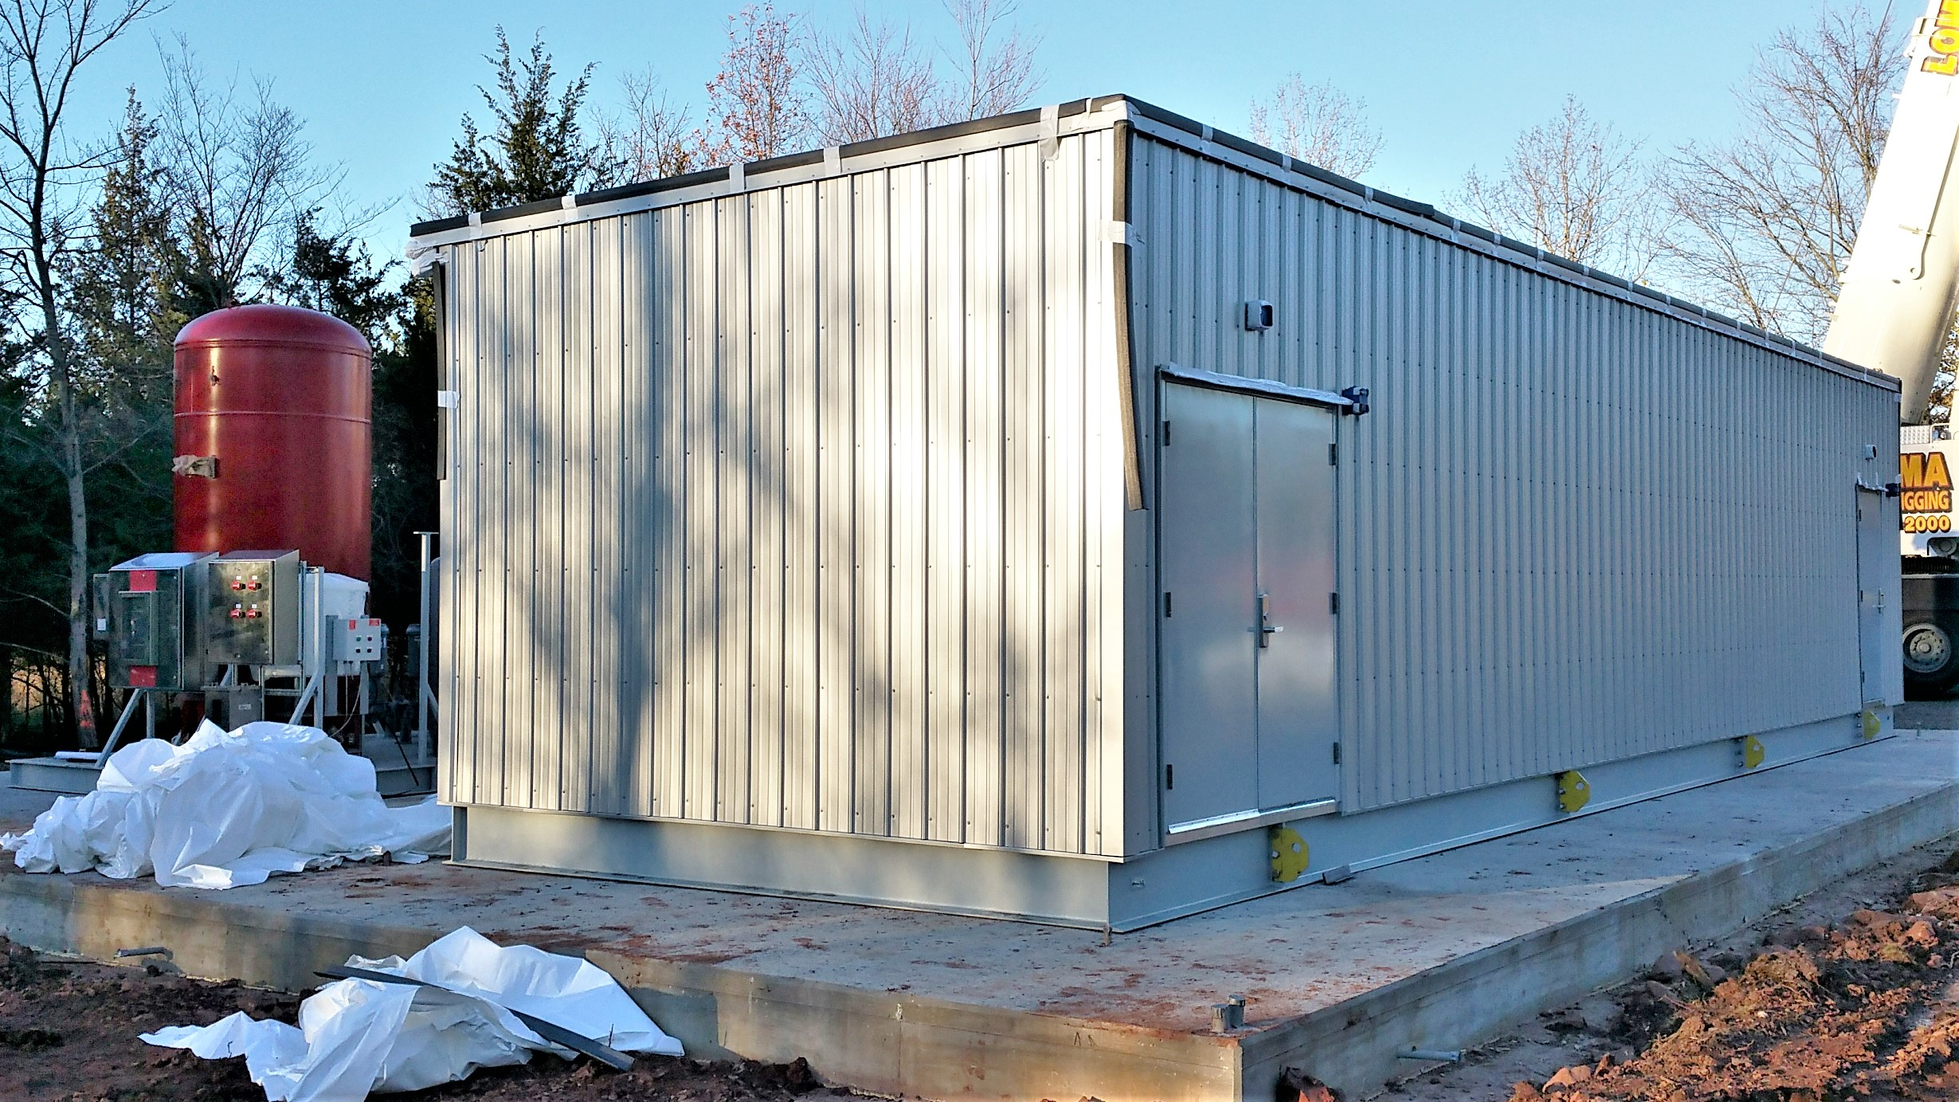
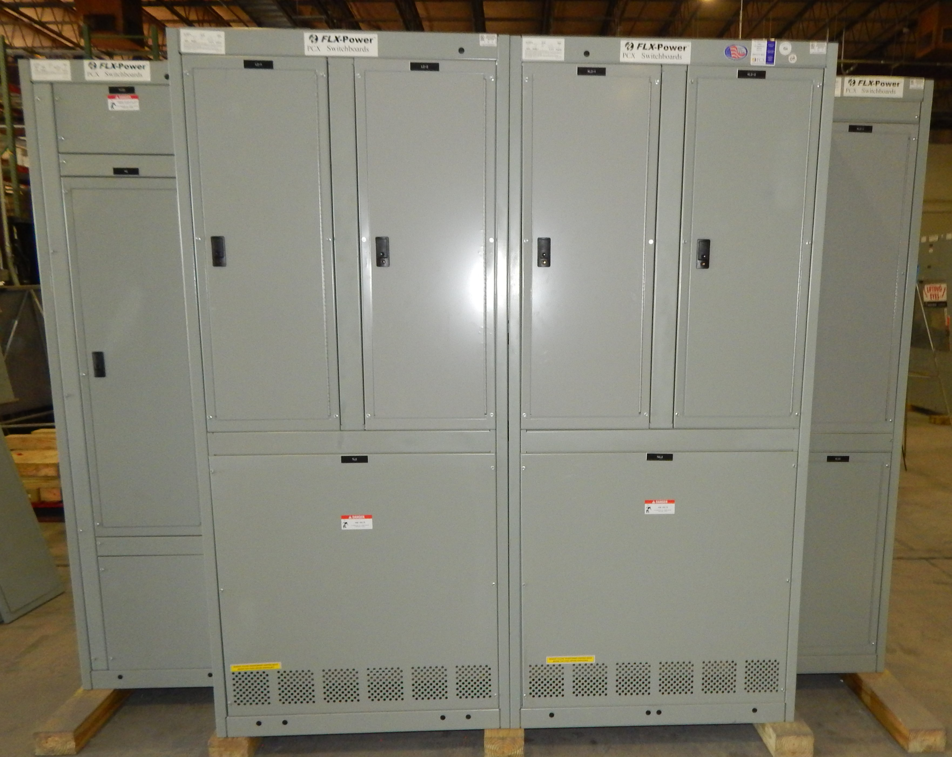
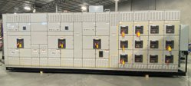
Product Portfolio
Custom Solutions
FLX-MDCTM
FLX-PowerTM
Design and integration of
modular equipment skids
Modular Data Centers –
all-in-one, UPS
UL-891 Integrated Switchboards
Hyperscale
Co-location
Edge
Retail
Healthcare
Higher Education
MDCs
Commercial Construction

Slide 10
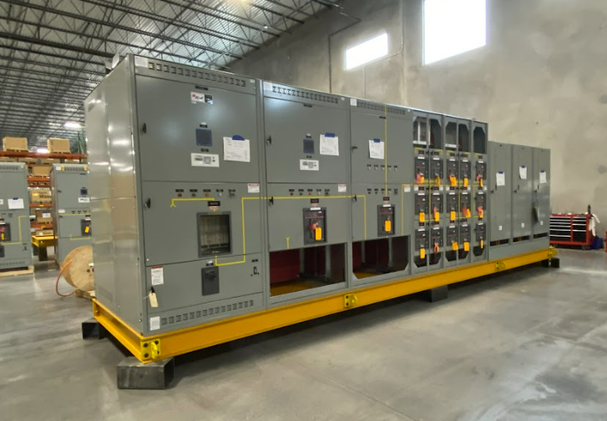
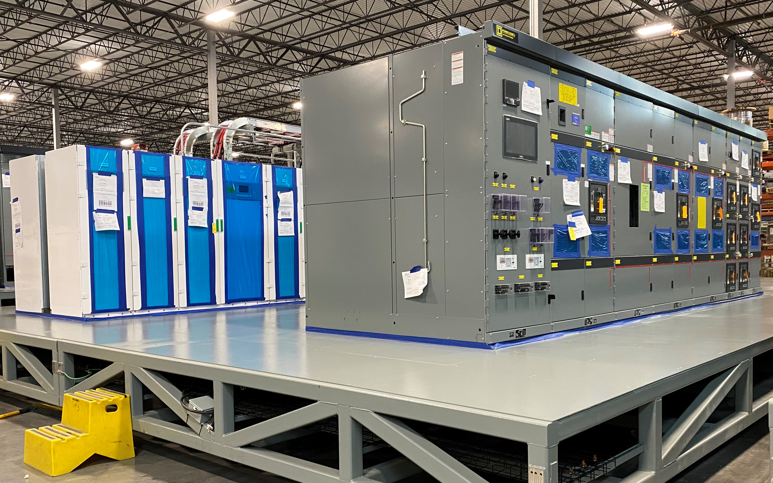
Custom Modular Electrical Skids

Slide 11
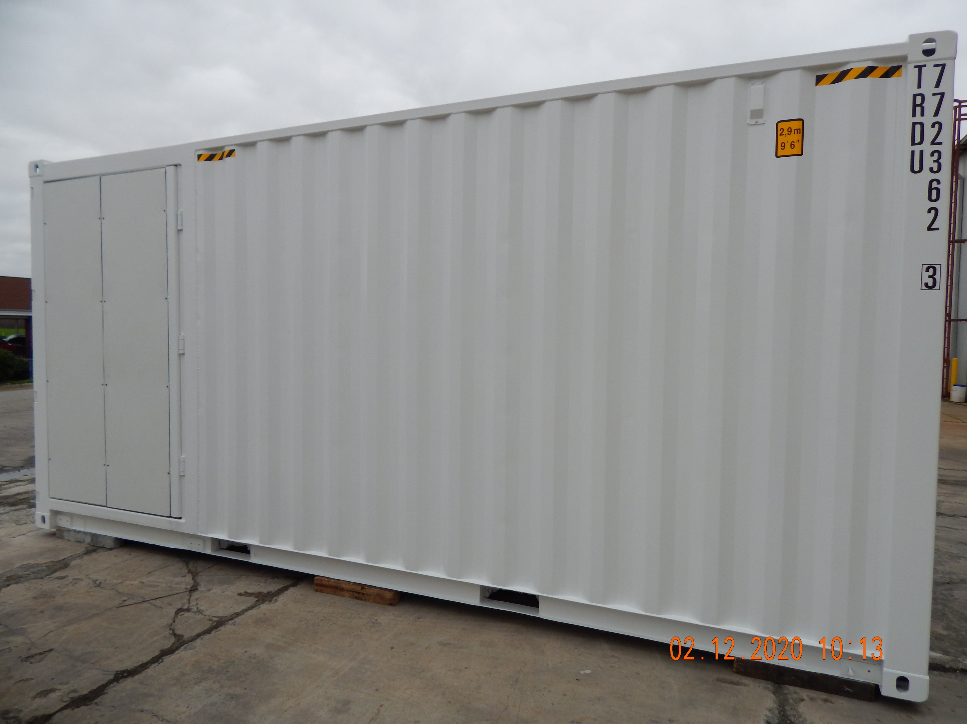
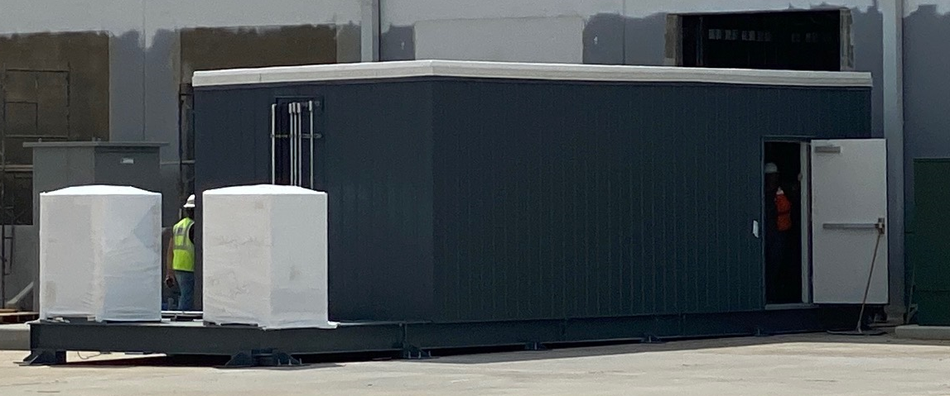
FLX-MDCTM: IT Capacity 25-500kW

Slide 12
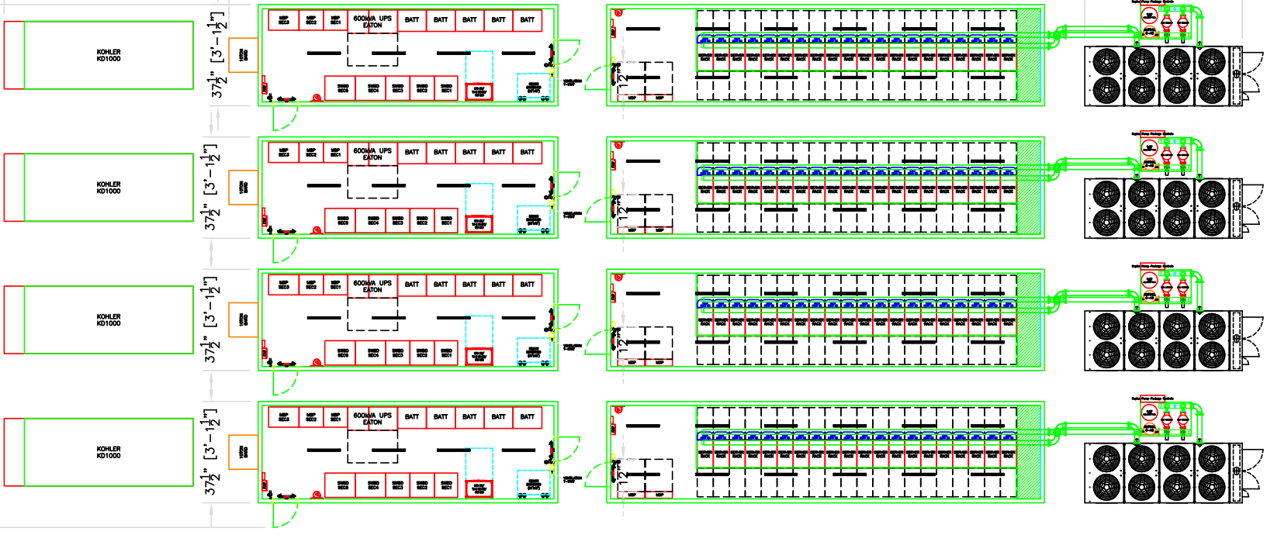
Plan Layout of 2MW Deployment
Approximately 155’ long by 65’ wide

Slide 13
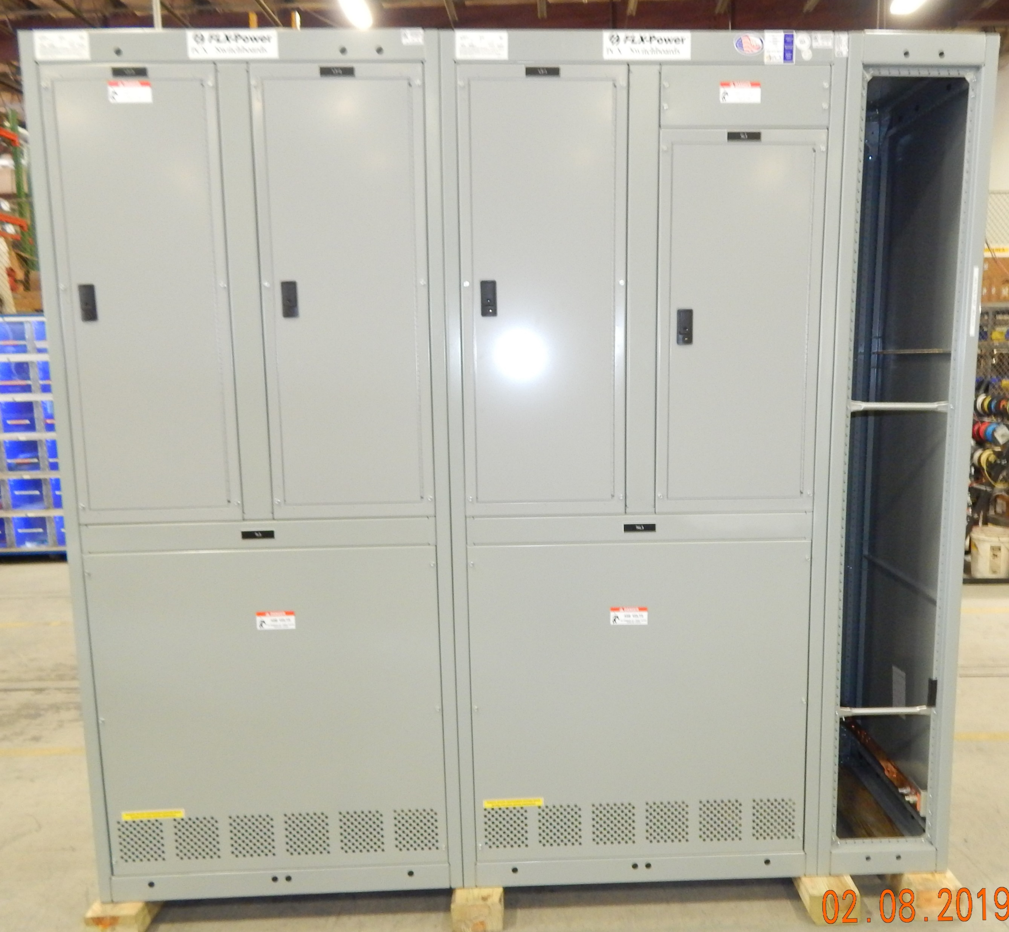
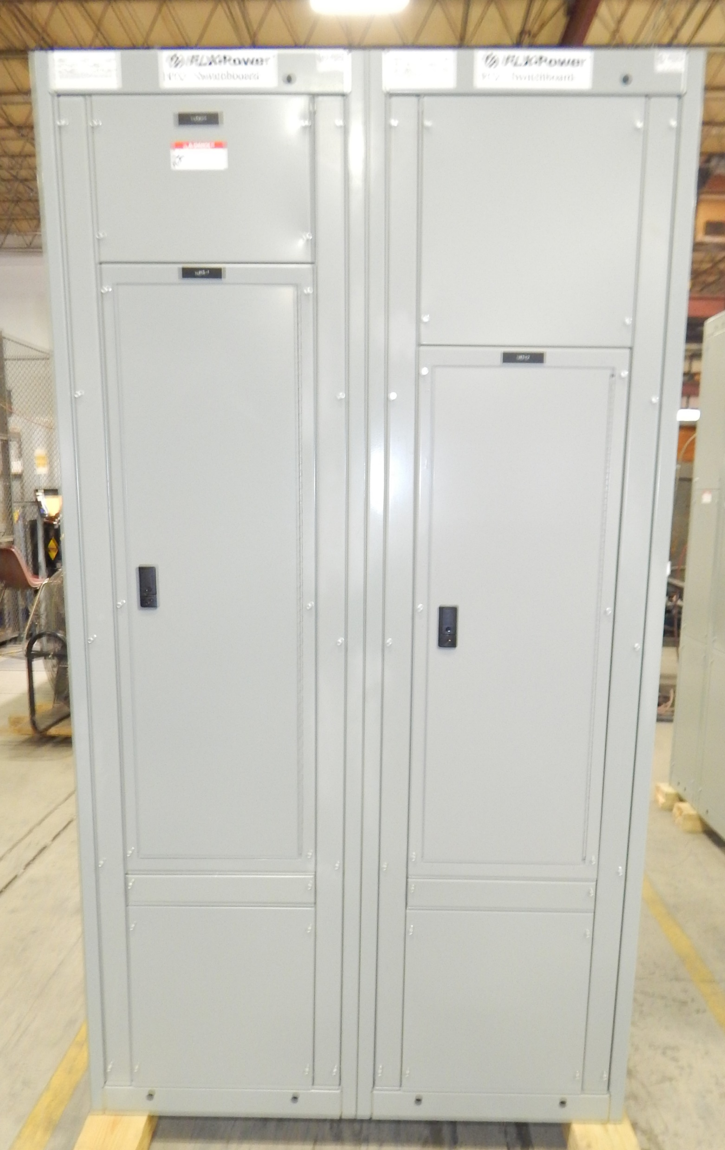
PCX Integrated Solutions – Commercial Switchboards

Slide 14
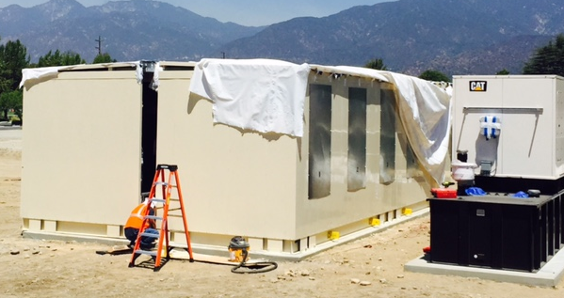
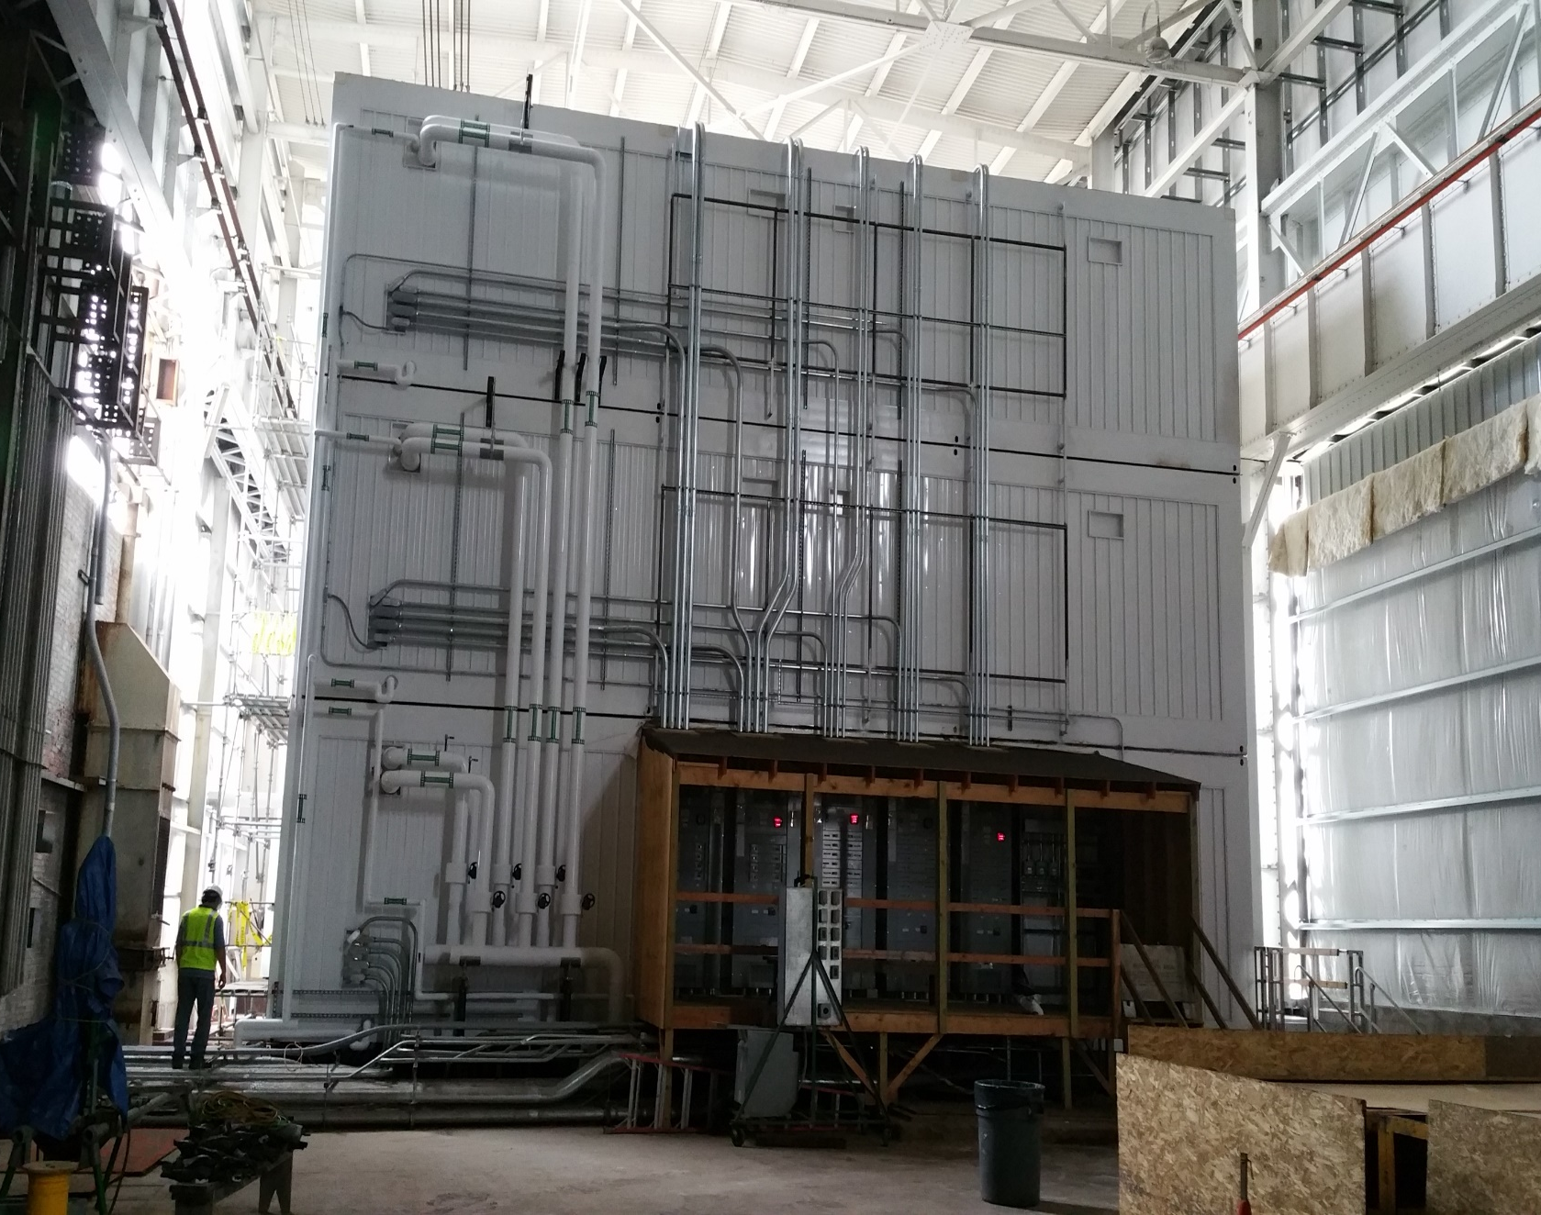
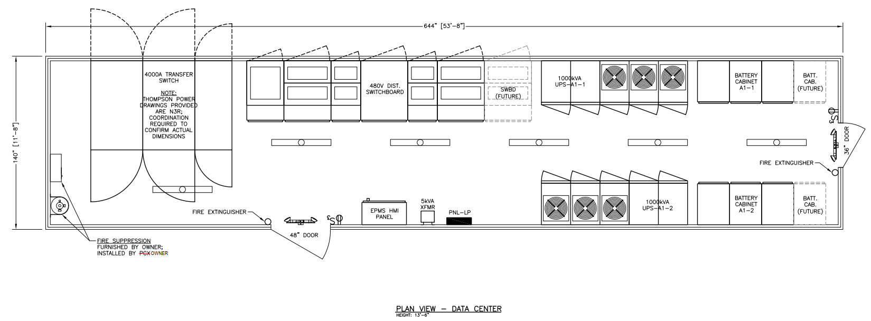
Other Custom Solutions
Multi-section buildings
Stacked IT/infrastructure units
Modular UPS

Slide 15
PCX Testing and Services
Pre-Shipping FWT Test and Certification
  1,000KW dedicated testing electrical service
  On-site load bank (1,000KW)
  Local access to 1-2Meg Gen-set
Delivery Coordination
  Contract transportation
  Crane and riggers procurement
  On – site receive and set
Field Services and Maintenance

Slide 16
Meeting Agenda
Introductions
Objectives for visit
PCX history
Facilities and core capabilities
PCX as part of the Hubbell family
Open discussion

Slide 17
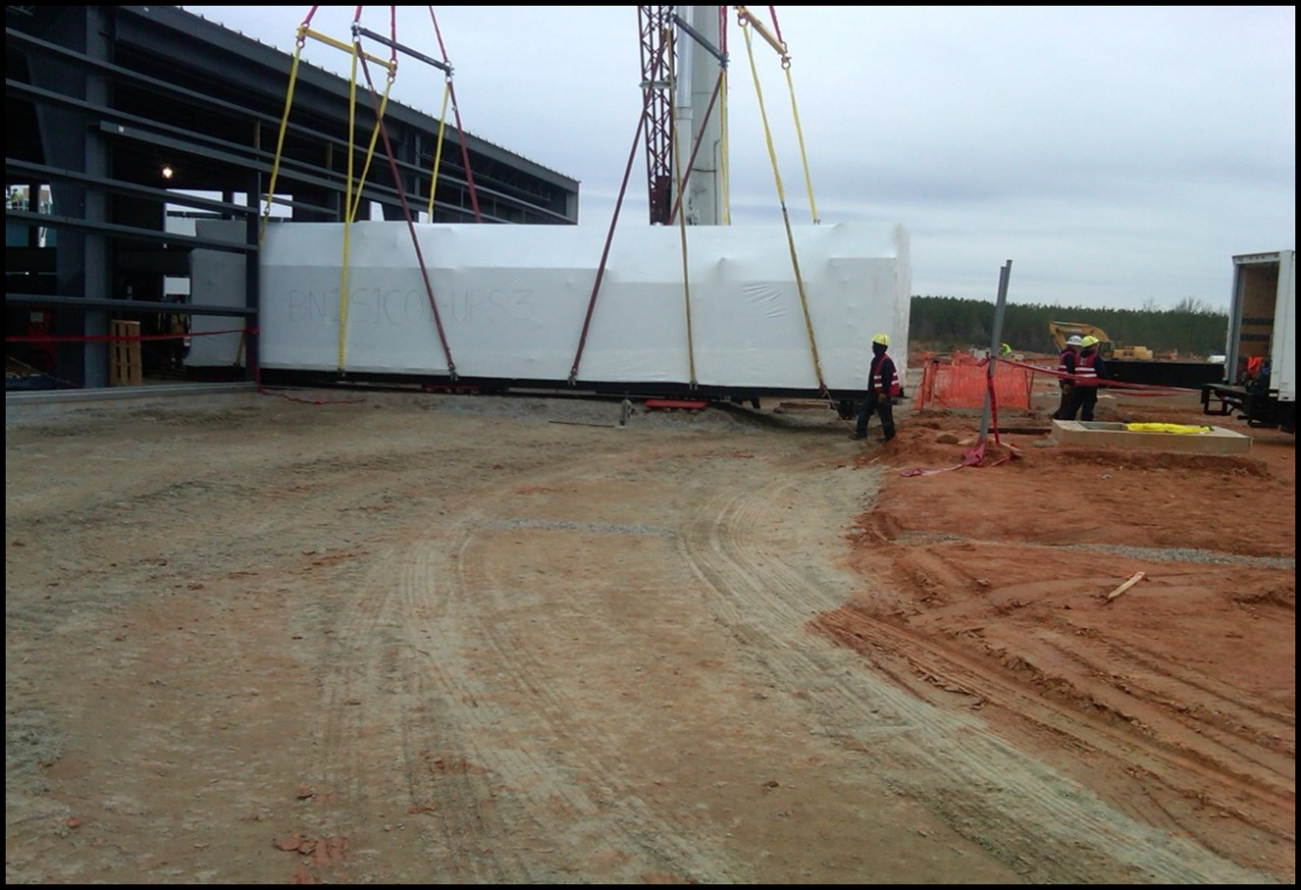
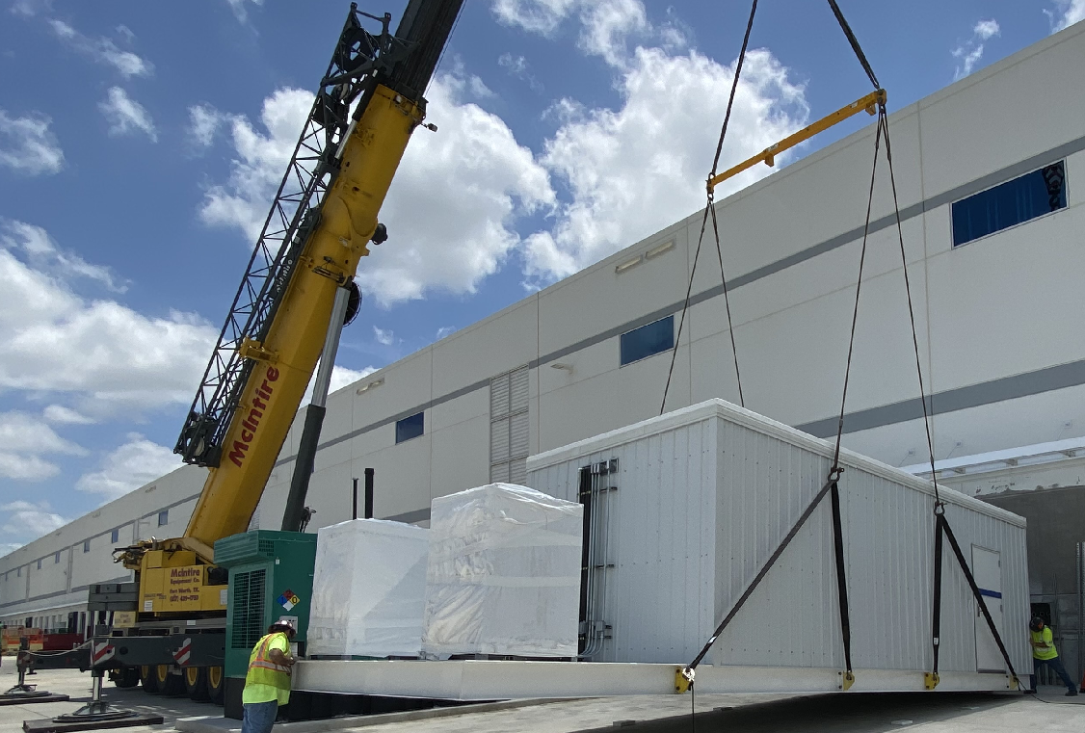
PCX Site Services
Rigging and Anchoring
Transport and Site Prep

Slide 18
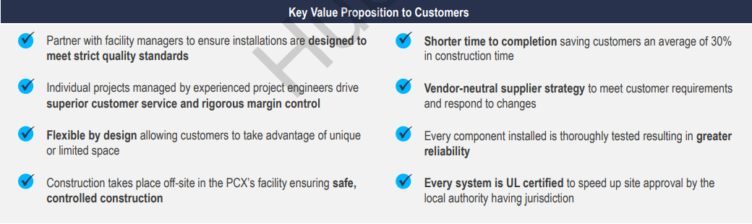
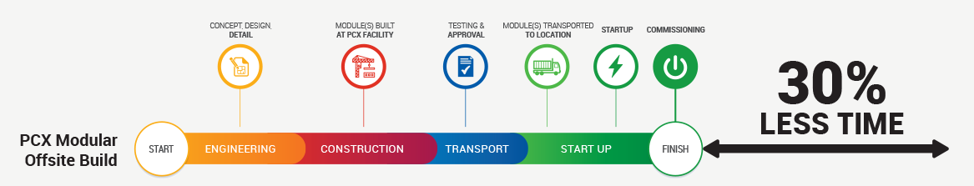
Value Proposition
Time savings from manufacturing concurrently with permitting, approvals, and building construction

Slide 19
Industrialized Buildings - Certification
NEC definition: Any building of closed construction made or assembled on or off the building site for installation on the building site (with few exceptions).
IIBC definition: Building of closed construction that conceals parts or processes of construction that cannot be inspected at the building site without disassembly, damage, or destruction.
PFS guidance:
  Contact AHJ prior to project commencement
  Equipment skids considered pieces of equipment

Slide 20
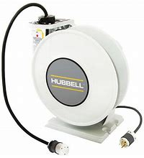

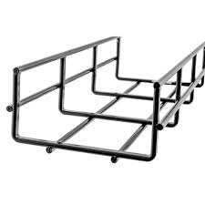
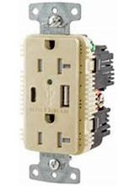


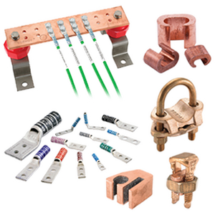
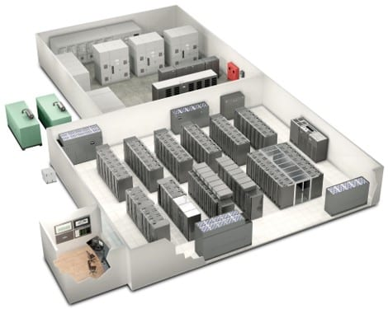
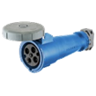
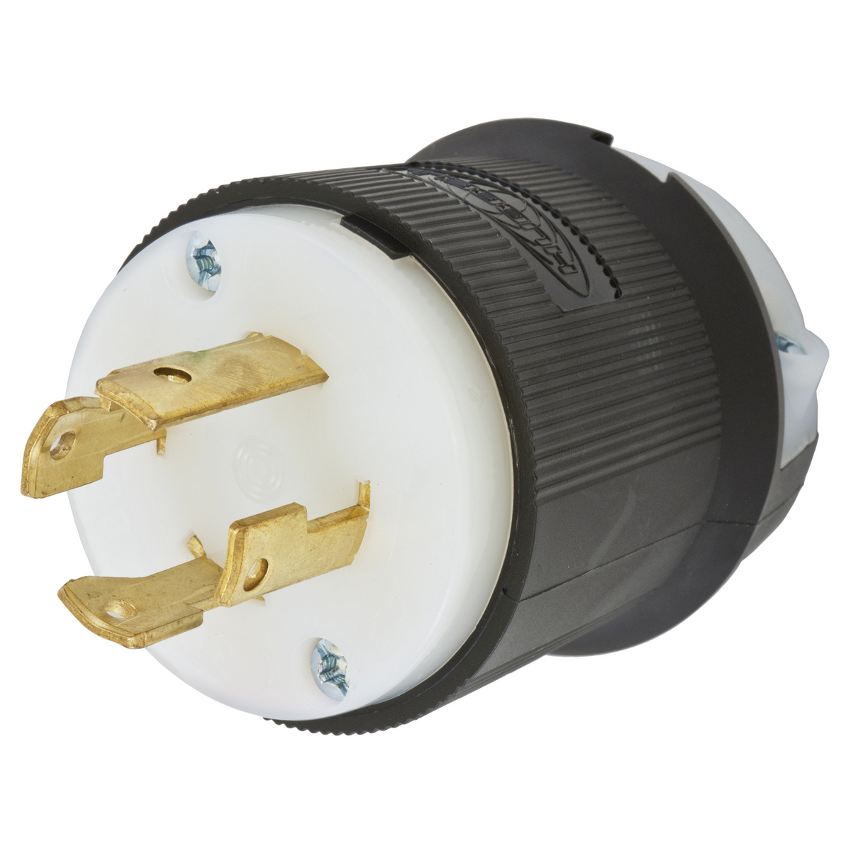



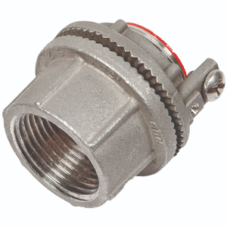

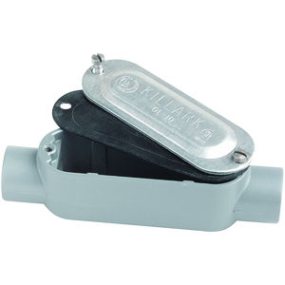
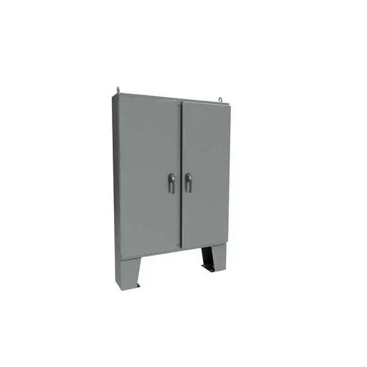

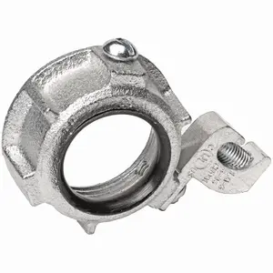
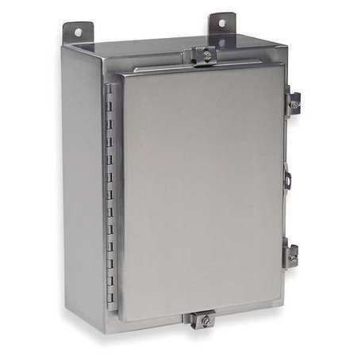

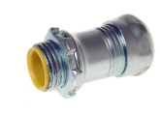

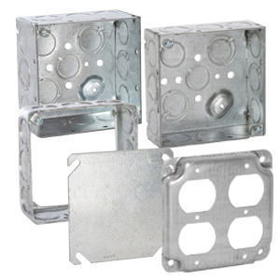
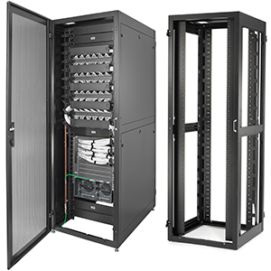
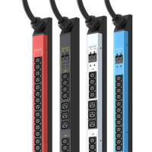

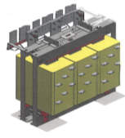
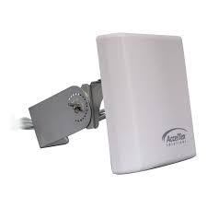



Synergy with Hubbell

Slide 21
Meeting Agenda
Introductions
Objectives for visit
PCX history
Facilities and core capabilities
PCX as part of the Hubbell family
Open discussion

Slide 22
Thank You!

